Slide 1


Calculating energy savings is unique because savings represent the absence of energy use. Participants will be equipped with an IMPVP toolset with scenario analytics to reduce the performance verification risks.
Malaysia committed to 45% carbon reduction by 2030 and net zero by 2050. The challenge is to transform the Net Zero ambitions into actions. Energy Efficiency is a key Decarbonization lever. IPMVP is the meter for energy and carbon efficiency baselining.
Overview
This two-day workshop will discuss how to operationalise EE and carbon reduction. This course will teach real-time energy monitoring, smart energy analytics, energy baselining following the International Performance Measurement and Verification Protocol (IPMVP), energy optimisation case studies and benchmarking to deliver sustainable energy savings.
One Free Meter Point with Installation, one-year free Smart Analytics & IPMVP platform
Eligibility: Organization with a minimum monthly electricity consumption of > 100,000 kWh/month, please register at the link below.
Free Energy Portal: https://mpc.nxcloud.co
1.
Familiarize yourself with the Climate-related Sustainability Landscape and Net Zero
2.
Understand the importance of Energy Efficiency
3.
Comprehend the importance of an Energy Management System framework
4.
Practical case study and exercise
Participants will understand the skillset and toolset needed to perform energy optimization projects.
Date: TBD
Time: 8.30 am to 5.30 pm
Venue: Hotel
Supported by:

Slide 2




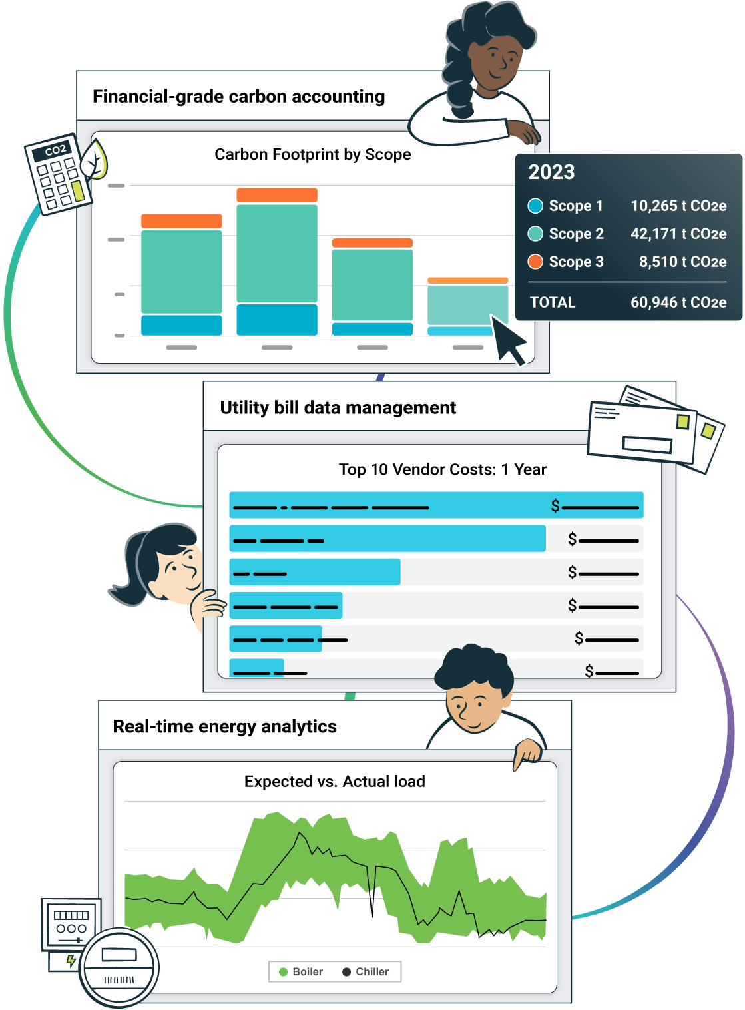
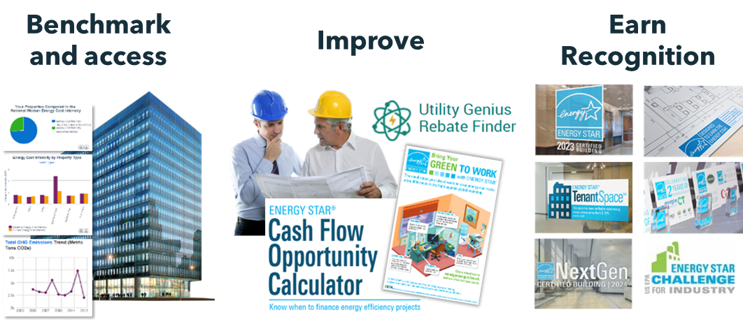
Energy Mastery Workshop
focusing on Skillset and Toolset with virtual REEM Support!
Benefits of Attending
this workshop
2-Day Energy Efficiency
Mastery Workshop
RM4,500 for 2 persons per company
Bundled with
One Meter Point with Hardware and Installation
One-Year Smart Analytics / IPMVP
Virtual REEM support
Trainer:
Mr. Mohammad Iskandar Majidi (PTE-0086-2010)
For inquiry:
Please contact: Alan (016-6434495)
Understand Malaysia’s Energy Policy & Standards, Energy Management System
Affordable Real-time Energy Monitor
Energy Analytical Skills with Smart Analytics & IPMVP
Learn about Energy Optimization
Compressed Air
Variable Speed Drive
HVAC & Chiller Plant Efficiency

