Slide 1



MESYUARAT PERBINCANGAN PENGISIAN PROGRAM MITI DAY 2022
MINISTRY OF INTERNATIONAL TRADE AND INDUSTRY
‘Driving Transformation, Powering Growth’

Slide 2
AGENDA
Kata alu-aluan oleh Pengerusi
Pembentangan program MITI Day
  Objektif MITI Day
  Highlights MITI Day 2016 - 2019
Perbincangan
  Senarai Jawatankuasa Kerja MITI Day 2022
  Penglibatan Kementerian dan Agensi lain
  Lokasi,Tarikh & Tema
  Pelan Lokasi
  Cadangan Pengisian Program
Hal-hal lain
Penutup
Notes:
Visibility is high through the public eyes for MITI agencies – evidence of effective outreach programs.
However, that is not the case for MITI, especially when dealing with public perception from outside Klang Valley.

Slide 3

OBJEKTIF MITI DAY
Objektif :
      Berkonsepkan ‘Hari Terbuka’
      Mempromosikan fungsi MITI dan Agensi kepada orang ramai
      Meningkatkan persepsi orang ramai terhadap imej MITI
      Mengeratkan hubungan di antara MITI serta agensi kepada orang ramai.
Notes:
Visibility is high through the public eyes for MITI agencies – evidence of effective outreach programs.
However, that is not the case for MITI, especially when dealing with public perception from outside Klang Valley.

Slide 4
HIGHLIGHTS MITI DAY
MINISTRY OF INTERNATIONAL TRADE AND INDUSTRY
‘Driving Transformation, Powering Growth’

Slide 5



MITI DAY (2016 – 2019)
34,100 PENGUNJUNG
24,849 PELUANG PEKERJAAN
JUMLAH PEKERJAAN DITAWARKAN : 3,435
MITI DAY (KL)
17 OKTOBER 2016
PENGUNJUNG : 8,000
PELUANG PEKERJAAN : 4,900
PEKERJAAN DITAWARKAN : 857
MITI DAY ZON UTARA (IPOH)
6 MEI 2017
PENGUNJUNG : 5,100
PELUANG PEKERJAAN : 9,886
PEKERJAAN DITAWARKAN : 703
MITI DAY ZON PANTAI TIMUR
(KOTA BHARU)
19 OKTOBER 2017
PENGUNJUNG : 6,500
PELUANG PEKERJAAN : 3,903
PEKERJAAN DITAWARKAN : 581
MITI DAY (SABAH)
19 OKTOBER 2019
PENGUNJUNG : 6,000 – 7,000
PELUANG PEKERJAAN – 4,095
PEKERJAAN DITAWARKAN : 613
MITI DAY (KL)
26 FEBRUARI 2018
PENGUNJUNG : 7,500
PELUANG PEKERJAAN : 2,065
PEKERJAAN DITAWARKAN : 681

Slide 6
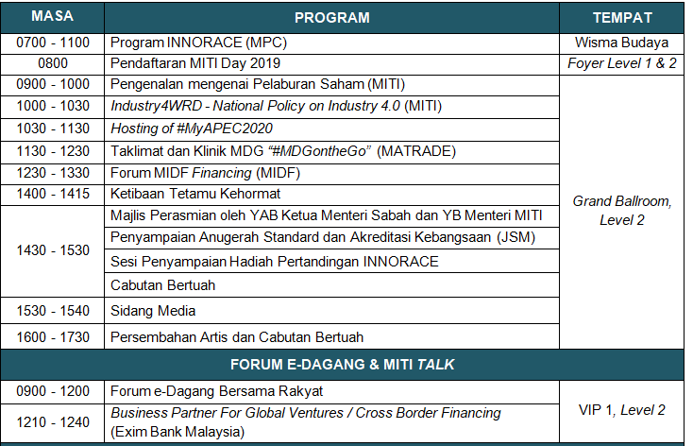
ATURCARA PROGRAM MITI DAY 2019

Slide 7
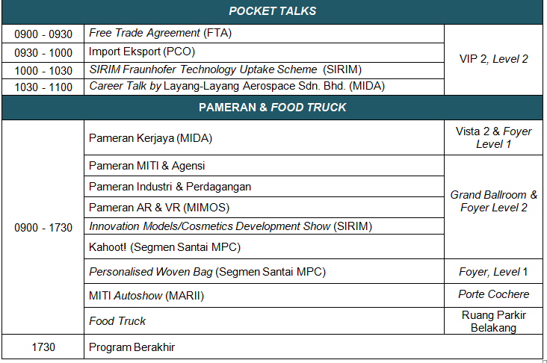
ATURCARA PROGRAM MITI DAY 2019

Slide 8
ATURCARA PERASMIAN MITI DAY 2019
MASA | PROGRAM
2.00 petang | Ketibaan Tetamu Jemputan
2.15 petang | Timbalan Menteri, KSU, TKSU, SPS dan Pengurusan Tertinggi Kementerian
2.30 petang | Ketibaan YB Datuk Darell Leiking Menteri Perdagangan Antarabangsa dan Industri
 | Ketibaan YAB Datuk Seri Panglima Haji Mohd Shafie Bin Haji Apdal Ketua Menteri Sabah
2.35 petang | Nyanyian Lagu Negaraku
2.40 petang | Bacaan Doa
2.45 petang | Ucapan alu-aluan oleh YAB Ketua Menteri Sabah
2.55 petang | Ucapan Perasmian oleh YB Menteri
3.05 petang | Gimik Pelancaran MITI Day 2019
3.15 petang | Sesi Penyampaian Anugerah Standard dan Akreditasi Kebangsaan (JSM)
 | Sesi Penyampaian Hadiah Pertandingan INNORACE
3.30 petang | Sidang Media

Slide 9
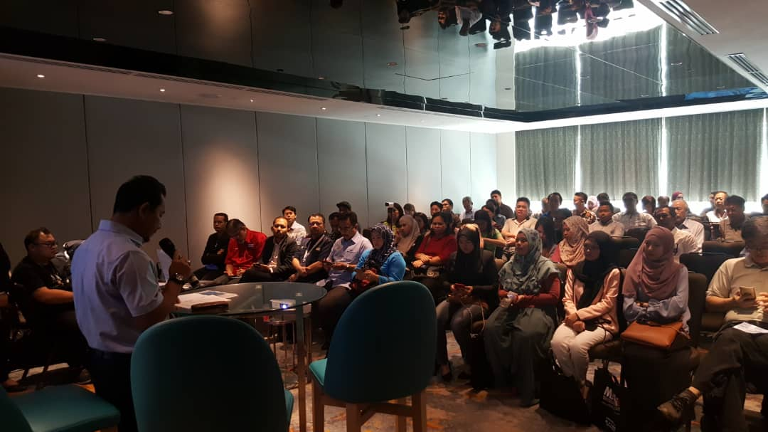
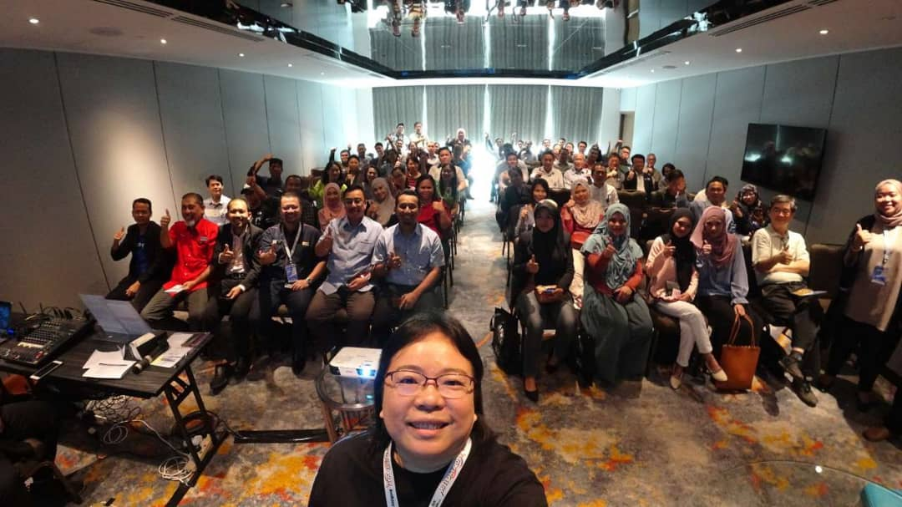
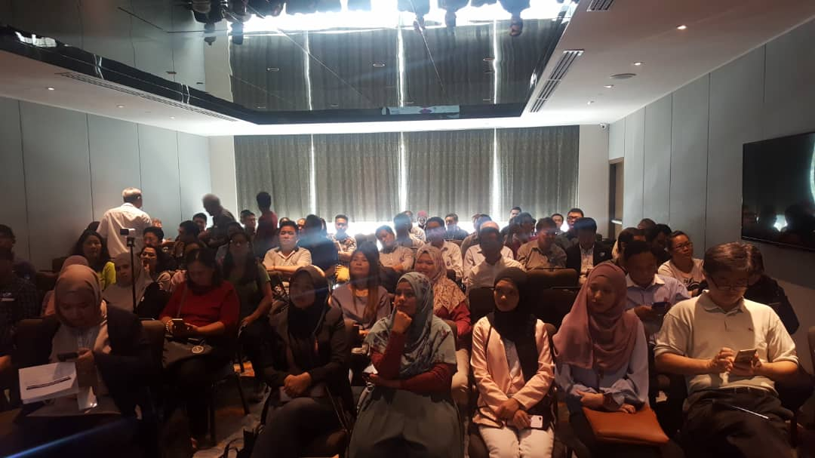
MITI DAY 2019

Slide 10
SENARAI JAWATANKUASA KERJA
MITI DAY 2022
MINISTRY OF INTERNATIONAL TRADE AND INDUSTRY
‘Driving Transformation, Powering Growth’

Slide 11
BIL. | JAWATANKUASA | AGENSI / BAHAGIAN
1. | PENGERUSI | TKSU(I)
2. | SEKRETARIAT INDUK | AKI, SERANTA & SAHAM
3. | JAWATANKUASA JEMPUTAN (PERASMIAN) | AKI, SERANTA & SAHAM
4. | JAWATANKUASA JEMPUTAN (PROGRAM) | MITI & AGENSI
5. | JAWATANKUASA KEWANGAN | BAHAGIAN KEWANGAN
6. | JAWATANKUASA KATA ALUAN | BPS
7. | JAWATANKUASA SIARAN MEDIA, LIPUTAN MEDIA & PROMOSI | UKS
8. | JAWATANKUASA GIMIK PERASMIAN | MARII
9. | JAWATANKUASA PERSEMBAHAN DAN ARTIS SERTA PENYELARAS ACARA CABUTAN BERTUAH | KOMITI
10. | JAWATANKUASA PENDAFTARAN | BPSM
11. | JAWATANKUASA CABUTAN BERTUAH (INTERNAL SPONSHORSHIP) | EXIM BANK, INVESTKL, MIDF
12. | JAWATANKUASA LOGISTIK | MPC
13. | JAWATANKUASA KESELAMATAN | JSM
14. | JAWATANKUASA I.T DAN TEKNIKAL | BPM/MARII
15. | JAWATANKUASA PROTOKOL | BAHAGIAN PENTADBIRAN
16. | JAWATANKUASA PENYELARAS PAMERAN | MATRADE
17. | JAWATANKUASA FOOD TRUCK | HDC
‘Driving Transformation, Powering Growth’

Slide 12
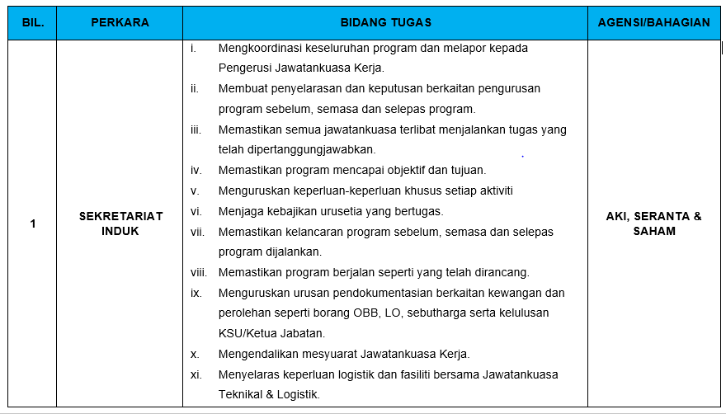
‘Driving Transformation, Powering Growth’

Slide 13
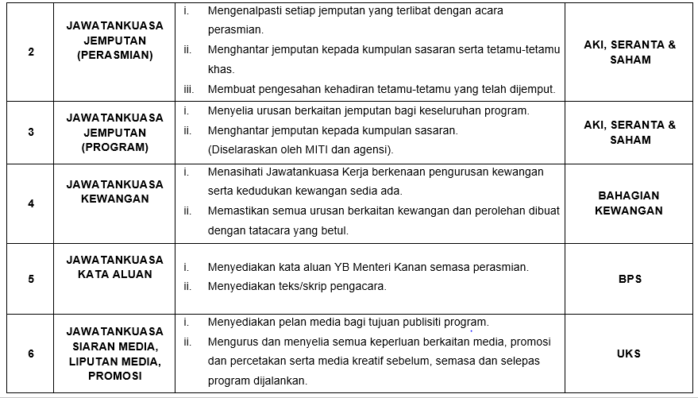
‘Driving Transformation, Powering Growth’

Slide 14
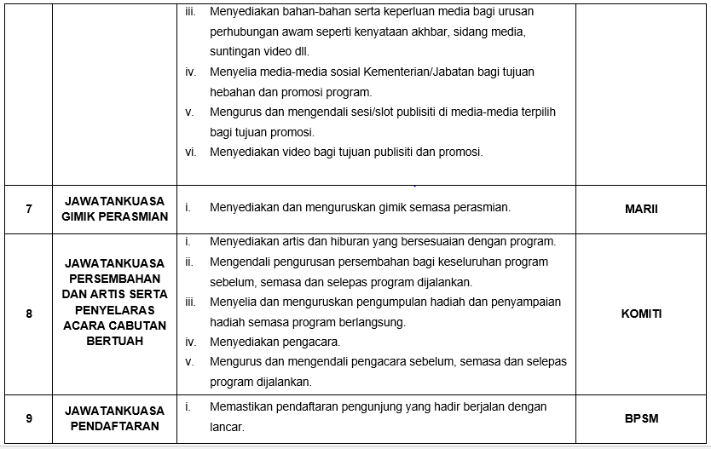
‘Driving Transformation, Powering Growth’

Slide 15
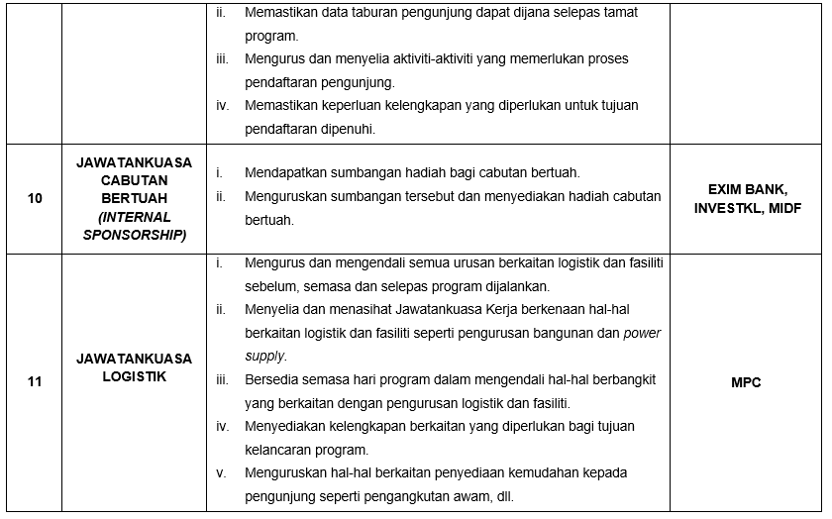
‘Driving Transformation, Powering Growth’

Slide 16
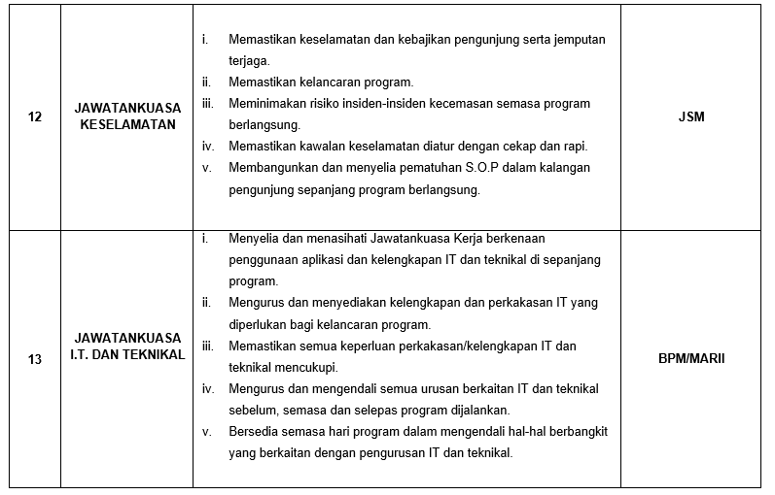
‘Driving Transformation, Powering Growth’

Slide 17
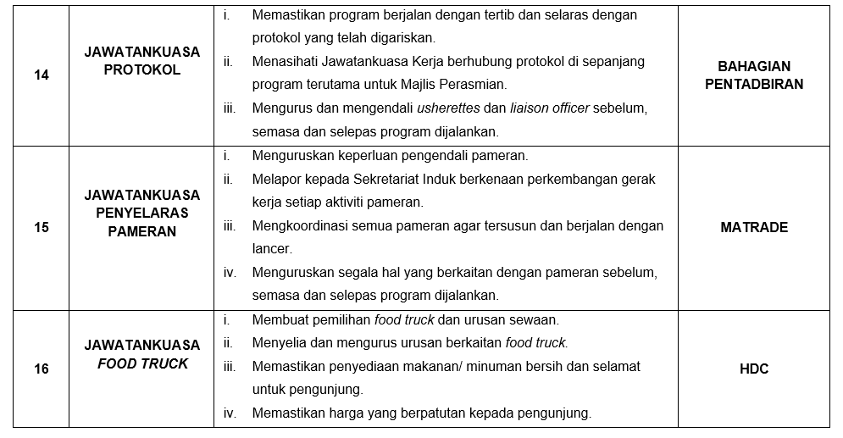
‘Driving Transformation, Powering Growth’

Slide 18
PERBINCANGAN MITI DAY 2022
MINISTRY OF INTERNATIONAL TRADE AND INDUSTRY
‘Driving Transformation, Powering Growth’

Slide 19














PENGLIBATAN AGENSI &
KEMENTERIAN LAIN

Slide 20






PENGLIBATAN AGENSI &
KEMENTERIAN LAIN

Slide 21



CADANGAN TARIKH, LOKASI DAN TEMA
MITI DAY 2022
Cadangan Tarikh:
            14 Mei 2022 – 15 Mei 2022 (Sabtu & Ahad)
Cadangan Lokasi :
            Parkir bersebelahan Melawati Mall
Cadangan Tema :
            TBC

Slide 22
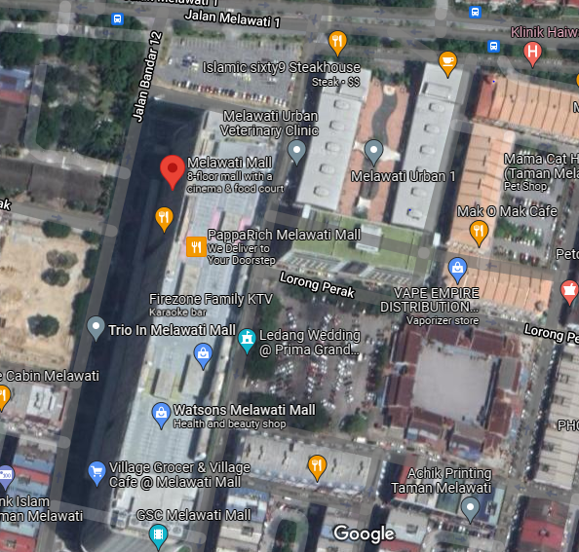
PELAN LOKASI MITI DAY 2022
TAPAK B
(Karnival Kerjaya)
24M
73M
77.5M
TAPAK A
(Tapak Utama)
67M

Slide 23
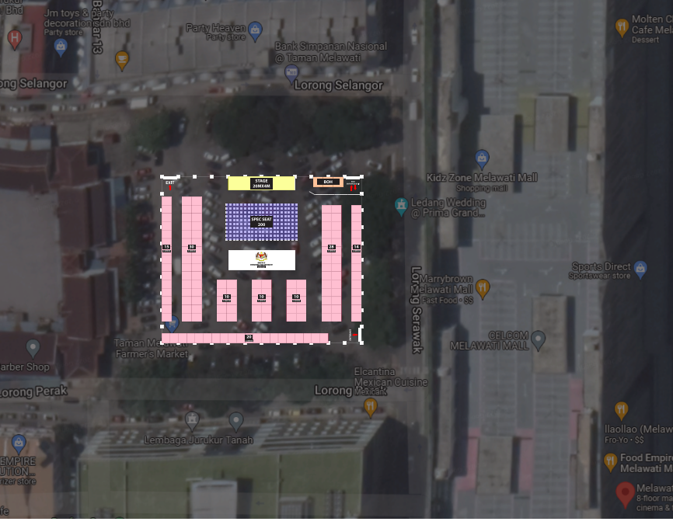
TAPAK A (TAPAK UTAMA)

Slide 24
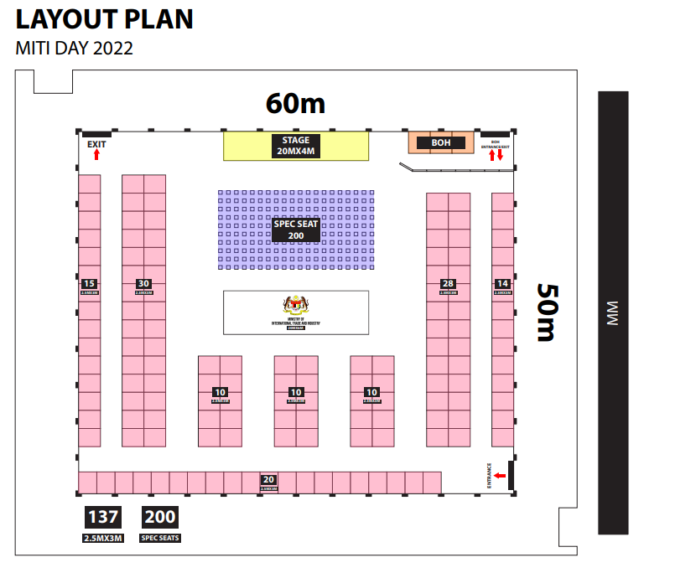
TAPAK A (TAPAK UTAMA)

Slide 25
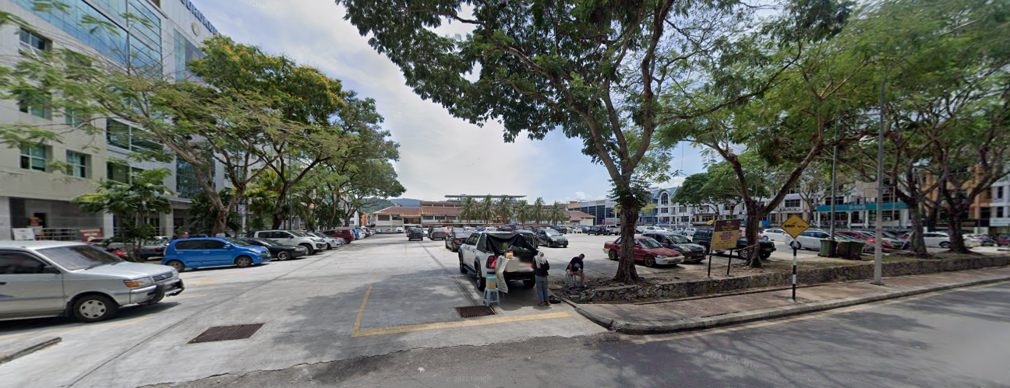
TAPAK A (TAPAK UTAMA)

Slide 26
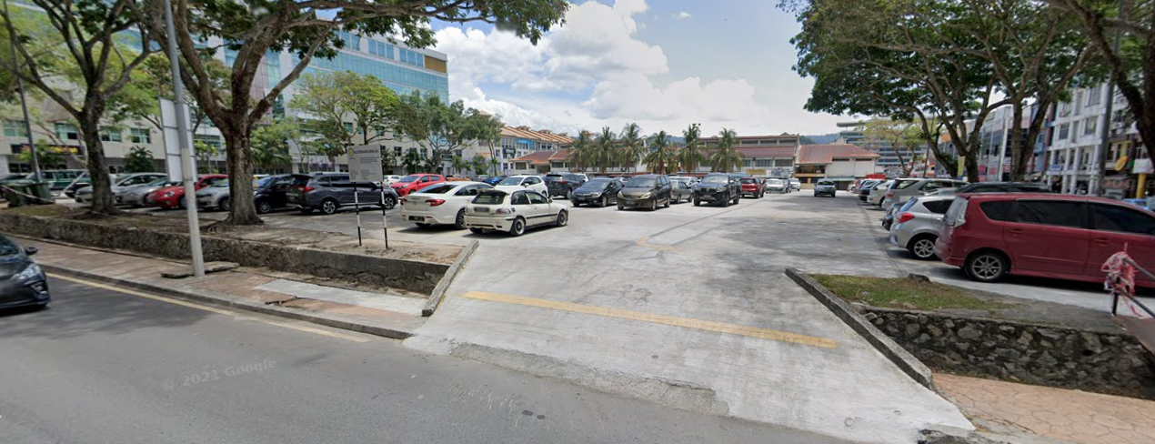
TAPAK A (TAPAK UTAMA)

Slide 27
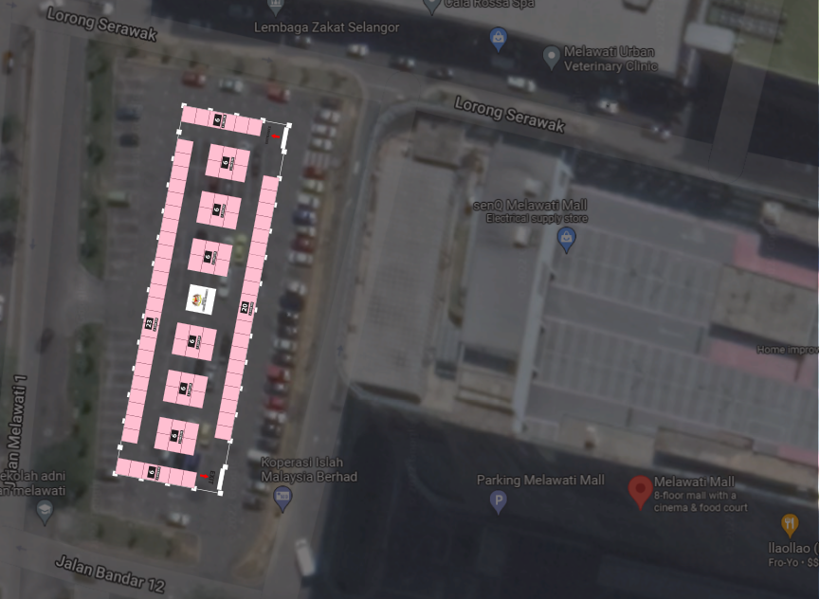
TAPAK B (KARNIVAL KERJAYA)

Slide 28
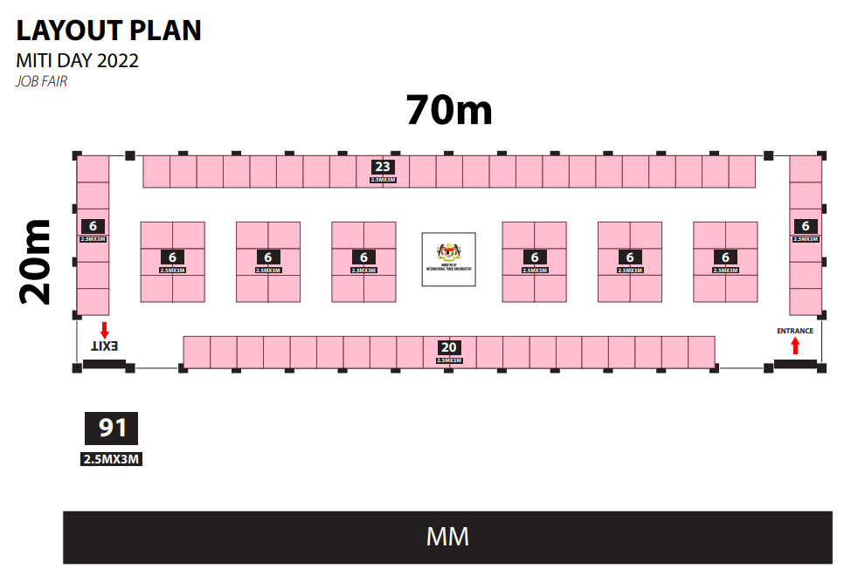
TAPAK A (TAPAK UTAMA)

Slide 29
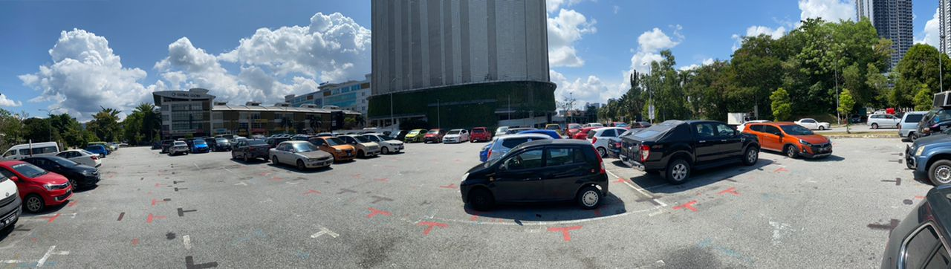
TAPAK B (KARNIVAL KERJAYA)

Slide 30
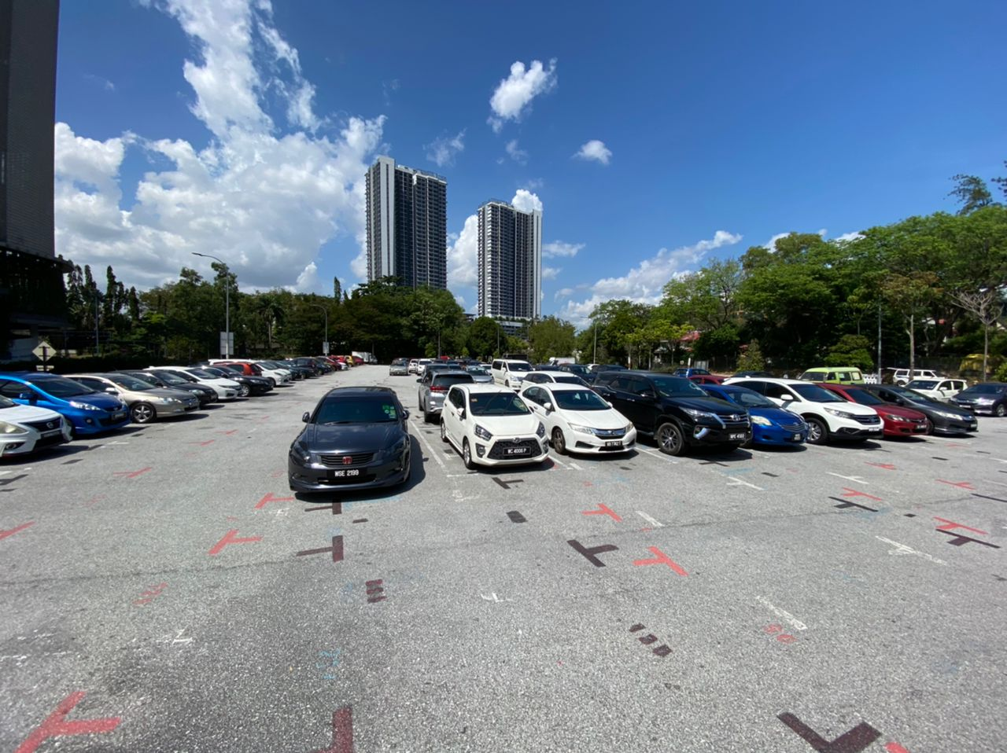
TAPAK B (KARNIVAL KERJAYA)

Slide 31
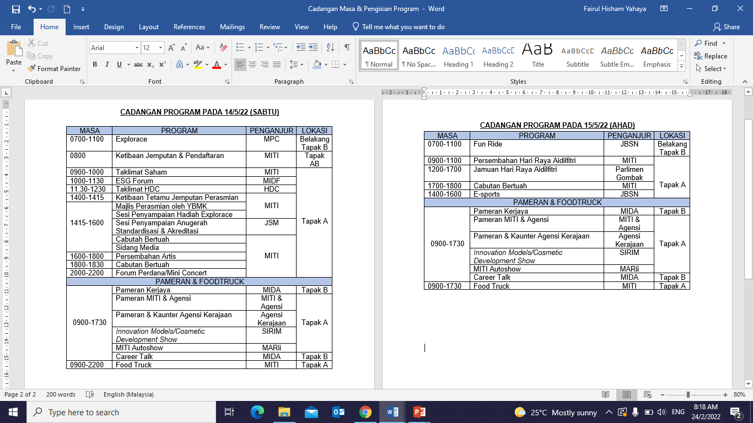
CADANGAN PENGISIAN PROGRAM PADA 15/5/22 (SABTU)
Notes:
Visibility is high through the public eyes for MITI agencies – evidence of effective outreach programs.
However, that is not the case for MITI, especially when dealing with public perception from outside Klang Valley.

Slide 32
CADANGAN PENGISIAN PROGRAM PADA 15/5/22 (AHAD)
Notes:
Visibility is high through the public eyes for MITI agencies – evidence of effective outreach programs.
However, that is not the case for MITI, especially when dealing with public perception from outside Klang Valley.

Slide 33
CADANGAN PENGISIAN PROGRAM
Kapsul Bumiputera (AP, Saham, Bual Bicara mengenai Saham, Kaunter Informasi)
Sesi Perkongsian Anugerah Kecemerlangan Industri (AKI)
Pameran MITI dan Agensi
Pameran AKI
Pameran Usahawan
Karnival Kerjaya
Pameran Automotif
Kesedaran dan promosi berkaitan IR 4.0
Program e-dagang
MITI POCKET TALK
TEA TALKS (MIDA, MATRADE, MIDF)

Slide 34
CADANGAN PROGRAM DAN AKTIVITI
BIL | PROGRAM | AGENSI | SASARAN PENGUNJUG
1. | Karnival Kerjaya | MIDA | 5000
2. | TBC | MATRADE
3. | Explorace | MPC
4. | ESG Forum | MIDF
5. | Podcast | MARii
6. | TBC | MSI
7. | TBC | SIRIM
8. | TBC | EXIM BANK
9. | Sesi Penyampaian Anugerah | JSM
10. | TBC | INVESTKL
11. | Pameran korporat HDC Kaunter ‘showcase’ – Halal Intergrated Platform’ (HIP) | HDC
12. | TBC | MRM
13. | TBC | NMIM
14. | Program larian dan berbasikal / e-sport | JBSN Selangor
15. | Jamuan Hari Raya | Parlimen Gombak
Notes:
Visibility is high through the public eyes for MITI agencies – evidence of effective outreach programs.
However, that is not the case for MITI, especially when dealing with public perception from outside Klang Valley.

Slide 35
HAL-HAL LAIN
MINISTRY OF INTERNATIONAL TRADE AND INDUSTRY
‘Driving Transformation, Powering Growth’

Slide 36
TERIMA KASIH
MINISTRY OF INTERNATIONAL TRADE AND INDUSTRY
Menara MITI
No. 7, Jalan Sultan Haji Ahmad Shah, 50480 Kuala Lumpur, Malaysia
Tel: 603-8000 8000 | Fax: 603-6201 2337 | Email: webmiti@miti.gov.my | Website: www.miti.gov.my

