Slide 1

Perancangan MSF 2023

Slide 2
REFLECTION OF 2022
MPC Go Digital
1
7
Studio MPC
Menamatkan Printer
Menamatkan Projektor
Meminimakan Mesin fotokopi
Sedang laksana integrasi eRO/eISO dan GRP
Penggantian Fasiliti Utiliti
2 tangki domestik
2 tangki Bomba
1 Cooling Tower
1 Panel Kawalan Pengagihan
Produk &
Perkhidmatan
6
2
Terokai Tenaga Hijau
Bangunan Baharu MPC
Rayuan MPC sedang dipertimbangkan
Kerja-kerja baiki oleh MRCB berjalan semula
Perjanjian akan dimeterai Q4 2022
3
5
4
Terokai Produk Baharu
Peruntukan Tambahan OE
Berjaya lobi OE MyMudah
Rangka Kerja ESG dimuktamadkan
10 pegawai Pelapor ESG GPM
3 juta untuk MyMudah 2023
3 Juta untuk selenggara & penggantian perabut
2 juta RM40 disalurkan

Slide 3

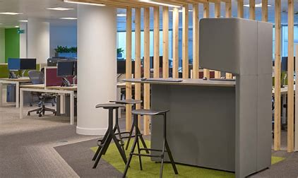

PLANS for 2023
DTU
Develop Digital Content & Provide Broadcasting Services
Manage Information Technology Licensing & Equipments
Establish Permanent In-House System & Application Development
Centralised Data for Core Departments
Developed Pilot Webpage/ System
Analyse New System Application
Establish IT Research
Offer research services similar MEDAC Project
Explore potential all internal systems
ADM
Manage Building & Facility
Explore Additional OE Budget for Building Maintenance
Manage Medical Benefits for Staffs and Pensioners
Coordinate MPC-MITI Parliament’s Q&A
Improve Operational Efficiency
Solar Project
Reduce Printing
Lobby for New MPC Headquarter
Manage & Operate MPC/MITI Exhibition
Manage Promotion and Nudging Materials
BTI
Explore New DE Programmes
Lead Transformation Change
Monitor & Evaluate DE Programmes
Cultivate BI in MPC
Manage Product & Services Quality
Experiment ESG for internal MPC and Future Product/Services
Develop Nexus ESG Unique Frameworks
Develop Nexus ESG Supply Chain Audit Mapping Framework
Collaborate with DMO/Nexus to organise ESG Conference
Budget: RM4 mil
Budget: RM5 mil
Budget: RM0.5 mil

Slide 4


PLANS for 2023
PCT
Manage & Improve Procurement processes
Manage & Coordinate SH/LP
Monitor & Evaluate DE Performance (JKTP & MTPK)
Manage & Evaluate JPPK
Explore Procurement Efficiency Projects
Develop External Talent Pool by programmes
Reduce Regional and HQ Procurement Competency gap.
KWA
Manage & Improve Payment processes
Apply yearly OE Budget for MPC
Manage and monitor GRP applications
Manage Overall Expenses
Register, Manage and Deregister Movable Assets
Explore Credit Card Services to DE Flight Services
Explore Decentralisation of DE Processing to Regional Offices
Budget: RM0.8 mil
Budget: RM0.1 mil

